Slide 1

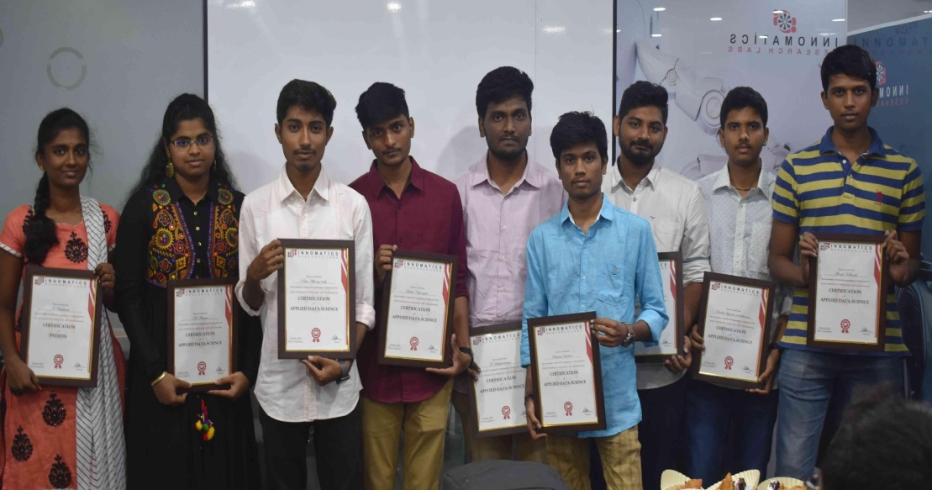
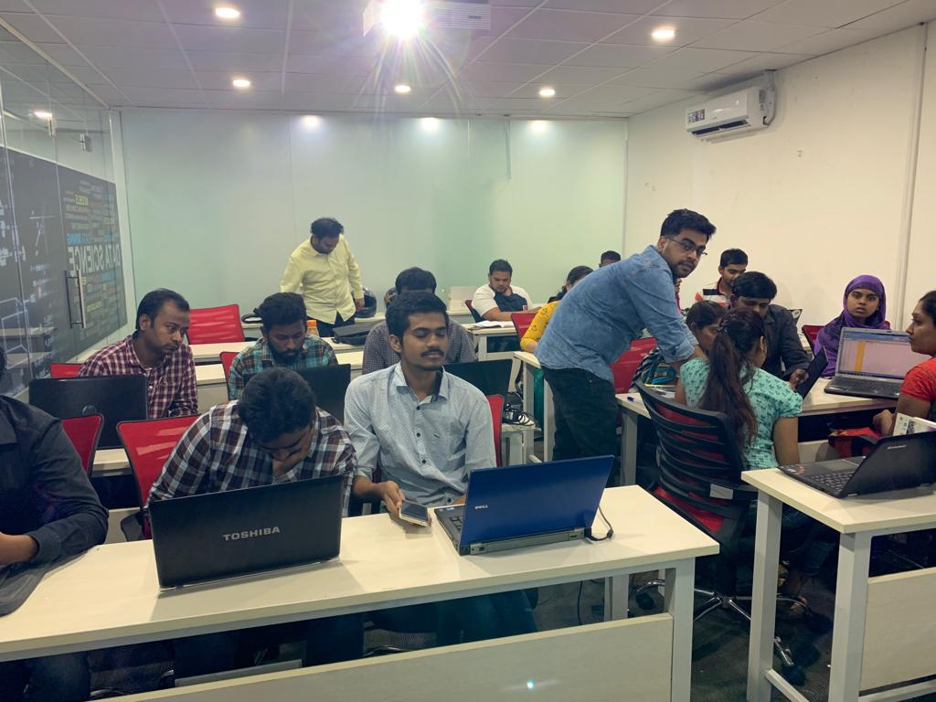



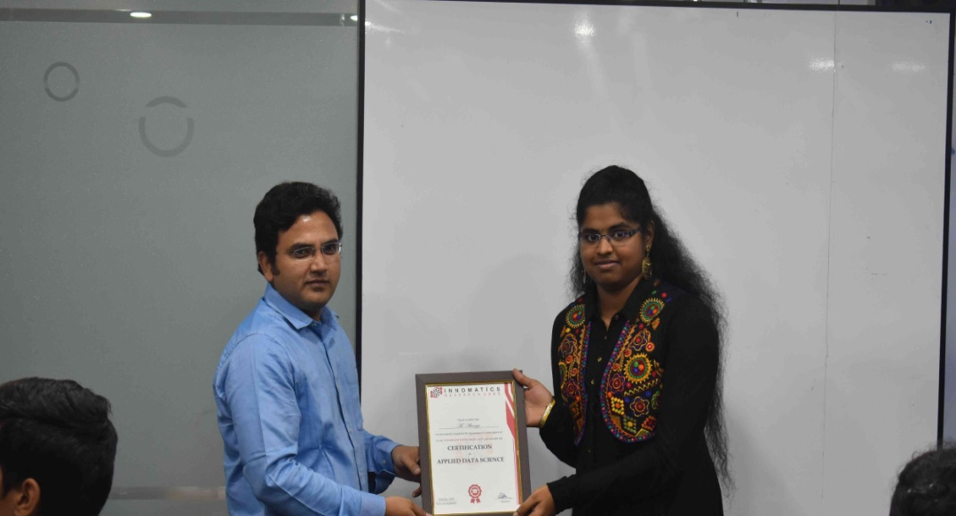

Slide 2
IPLT20
Analysis of Performance of Players of IPLT20 (2015-2019)

Slide 3
About me
Name: Niji Narayanankutty
Location: Kerala
B- Tech-Information Technology ,MBA-HR & Systems
Why Data science:
As world is getting digitalized lots and lots of data is being generated every seconds. Study of these data and their analysis is getting more and more important . Found interesting on this and chose Data science to shift my career to have a new start for long term career .
Work Experience :
3 years experience in HR Industry. Currently on maternity break
What like you about Informatics Research lab:
The main thing I found interesting is the mentoring sessions in which we can reach out our mentors for any clarifications. The lectures are very informative teaches from basics to advance so we can learn from scratch.

Slide 4
Website
Website used for scraping :
URL: https://www.iplt20.com/stats/2016/most-runs
Data(Variables ):
Total runs, Average , Strike rate, Balls faced, Matches of the the players in IPLT20(2015-2019) .The performance of employees are analyzed based on these variables.

Slide 5
IPLT20(2015-2019)
Use Case
The project aims to analyze the performance of players based on their total runs, average runs, Strike rate in all seasons from (2015-2019).This helps to find the consistent performers of the seasons
This helps to predict the performance of the players in upcoming seasons .

Slide 6
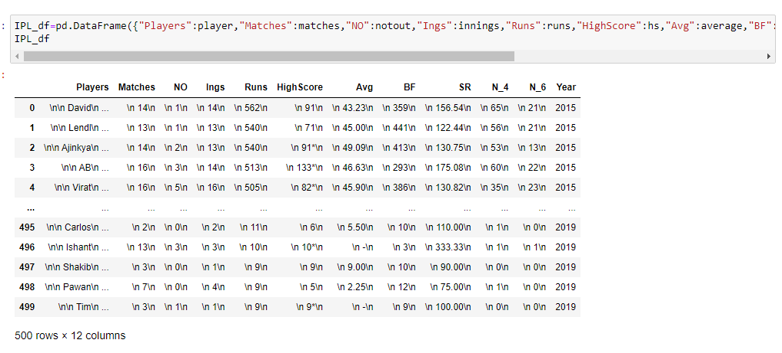
Web scraping
Data obtained after scraping :
Web scraping is done using Beautiful Soup library in which data is pulled out of HTML code

Slide 7
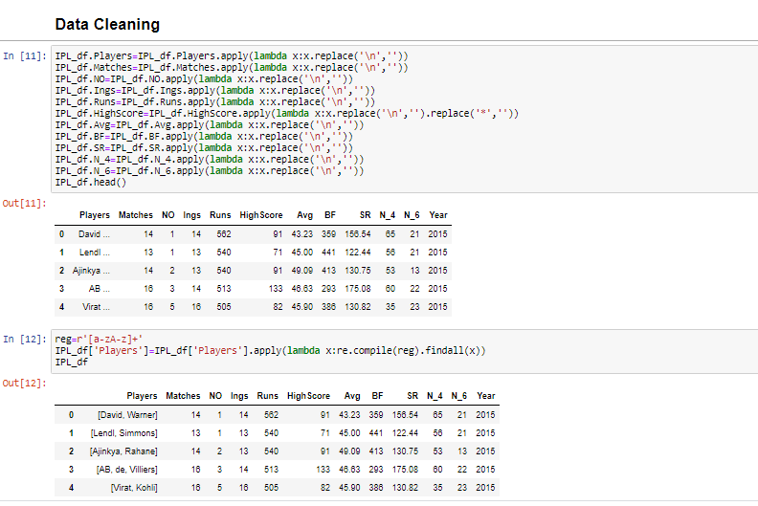
Data Cleaning
Data Cleaning:
The spaces are removed using lambda function and replace method .By using regex the players data has been retrieved

Slide 8
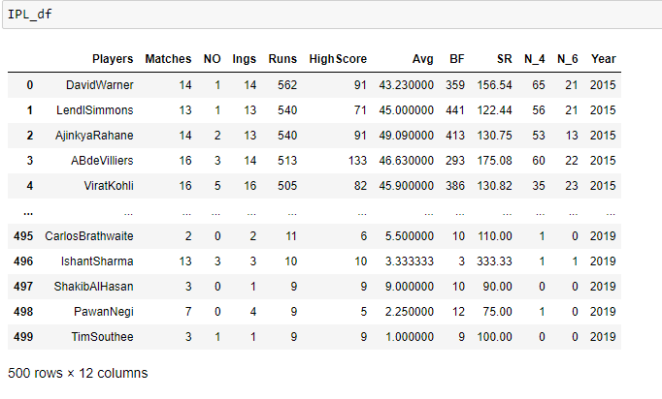
Exploratory Data Analysis (EDA)
Data Frame :

Slide 9
Data Visualization
Univariate Analysis:
Analysis of only one variable to summarize the data and finds patterns in them.
Bivariate analysis:
It involves analysis of two variables for determining the relationship between them
Multivariate Analysis :
Analysis multiple variable to find the relationship between then and their relevance to the problem

Slide 10
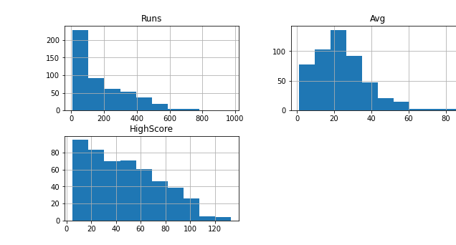
Univariate Analysis
Histogram:
Histograms shows the distribution of data
From the histogram we can infer the following
Shows the distributions of data of IPLT20(2015-1019)
Runs distribution is highly right skewed and maximum run rate distributed between 0-200
Average is also right skewed and maximum average rate falls between 20-40 interval
High score data is right skewed and maximum high score of the players are around 10-40 interval

Slide 11
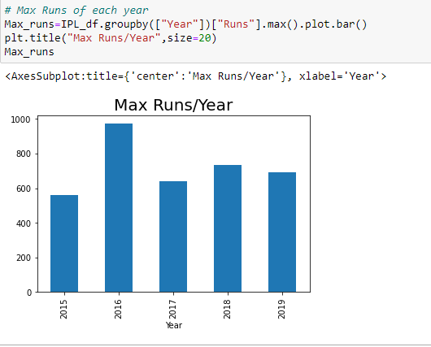
Univariate
Bar Graph:
Bar graph shows categorical data and their corresponding values
From the bar graph we can infer the following:
The maximum runs are in the year 2016 and min runs in the year 2015

Slide 12
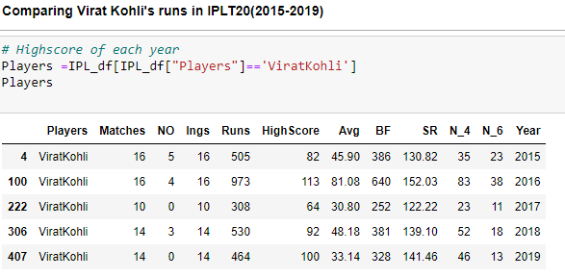
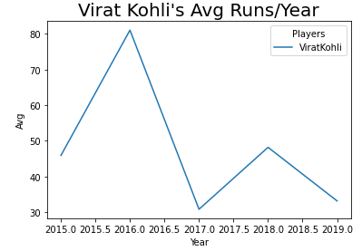
Univariate
Line Graph :
Plotting line graph to analyze the trend of Virat Kohli's average runs in IPLT20(2015-2016)
The below graph shows the average run is highest in 2016 and lowest in 2019.
This way we can see the average for each players .

Slide 13
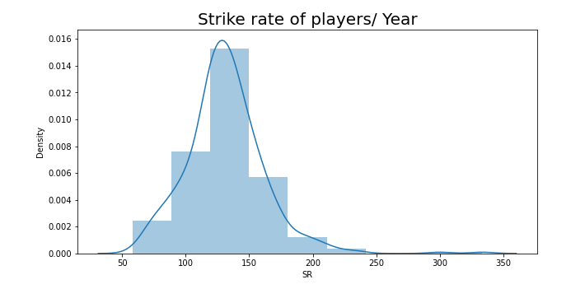
Univariate
Distribution plot:
Distribution plot combines the histogram and kernel density plot
From the plot we can infer the following :
It shows the distribution of strike rate of players of IPLT20(2015-2019)
The Strike rate of players has a normal distribution and most strike rate falls between range 120-150 range

Slide 14
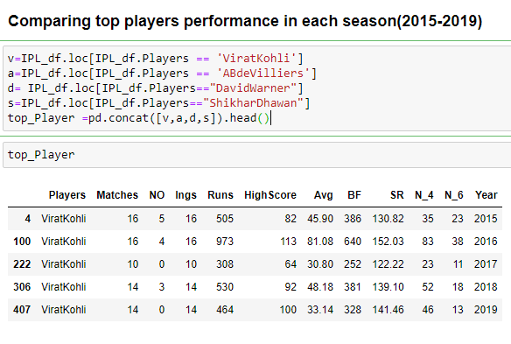
Bivariate analysis
For Bivariate analysis the following players data are taken for the comparison of their performance in IPLT20(2015-2019)

Slide 15
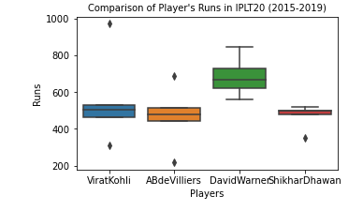
Bivariate
Categorical plot:
1.Box Plot:
Box Plot
Comparing the top players runs in each year IPLT20 (2015-2019)
From the below plot we can infer the following :
David Warner’s run rate is higher than the other players .
By using box plot we can analyze the run rate of different players and can find out whose run range are higher than others .

Slide 16
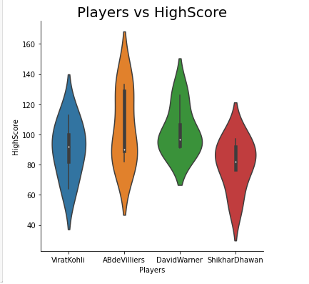
Bivariate
2. Violin Plot:
Violin plot is the combination of KDE and Box Plot
From the plot we can infer the following:
It shows the distribution and the range of highest score of players in IPLT20(2015-2019)
Ab De Villiers has highest score than the other players
David Warner highest score range is better than other players

Slide 17
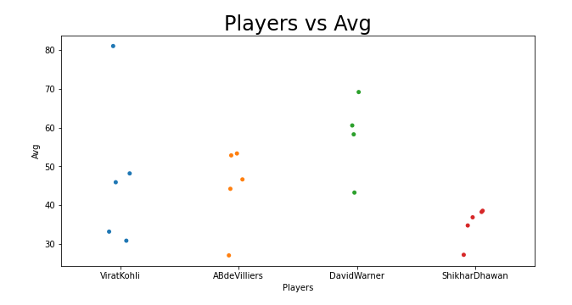
Bivariate
3. Strip Plot:
Strip plot is alternative to histogram and distribution plots for small datasets
From the plot we can infer the following :
The plot shows the distribution of average scores of players in IPLT20(2015-2019)
Virat Kohli has the highest average of all players in seasons (2015- 2015)
David Warner range of average run rate is higher than other players
From this we can conclude that David Warner avg runs is better than other players

Slide 18
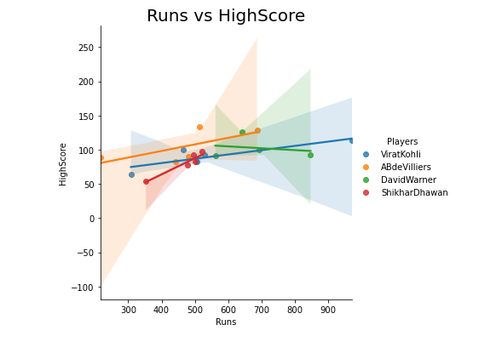
Bivariate
Numerical Plots:
1. Regression Plot:
Regression plots are used to depict the relationship between data.
The plot compares the relationship between runs and High score of top players
From the plot we can infer the following :
All players the runs and High Score is positively correlated
David Warner the high score has no relation with high score

Slide 19
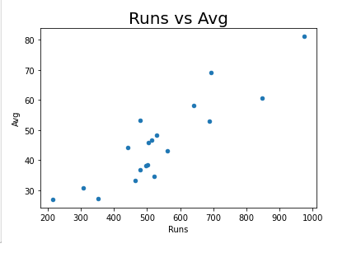
Bivariate
2. Scatter Plot :
Scatter plot is to find the co relation between the variables.
The plot shows the runs and average of the players has a positive correlation i.e. players with highest runs have highest average

Slide 20
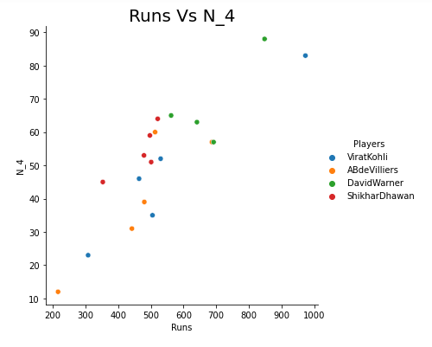
Bivariate
3.Relational Plot:
Relational plot shows the statistical relation between points
Shows the relation between the players runs and the N_4 scored for the seasons (2015-2019)
We can see a positive correlation between runs and N_4 for all players except David Warner

Slide 21
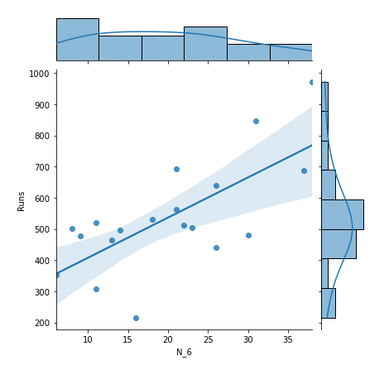
Bivariate
4. Join Plot:
Joint plot shows the distribution of variables as well as the relationship between them
From the plot we can infer the following:
The plot shows the distribution of N_6 and runs of players from season(2015-2019)
The maximum Runs of each player is between 400-600
The maximum N_6 of the players is between 1-25
There is correlation between N_6 and Runs

Slide 22
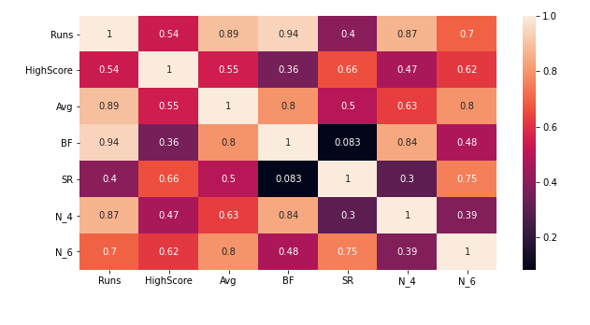
Multivariate
Heat Map:
Heat map shows the correlation between data
From the plot we can infer the following
In the plot the relationship varies from 0-1 and is represented in colored boxes .
1-perfect correlation
Runs scored by the players are highly correlated to average, Balls faced and N_4
Avg score is correlated to N_6,BF and Runs
BF is correlated to runs Avg and N_4
SR is correlated to N_6
N_4 is correlated to runs and BF
N_4 is correlated to Avg

Slide 23
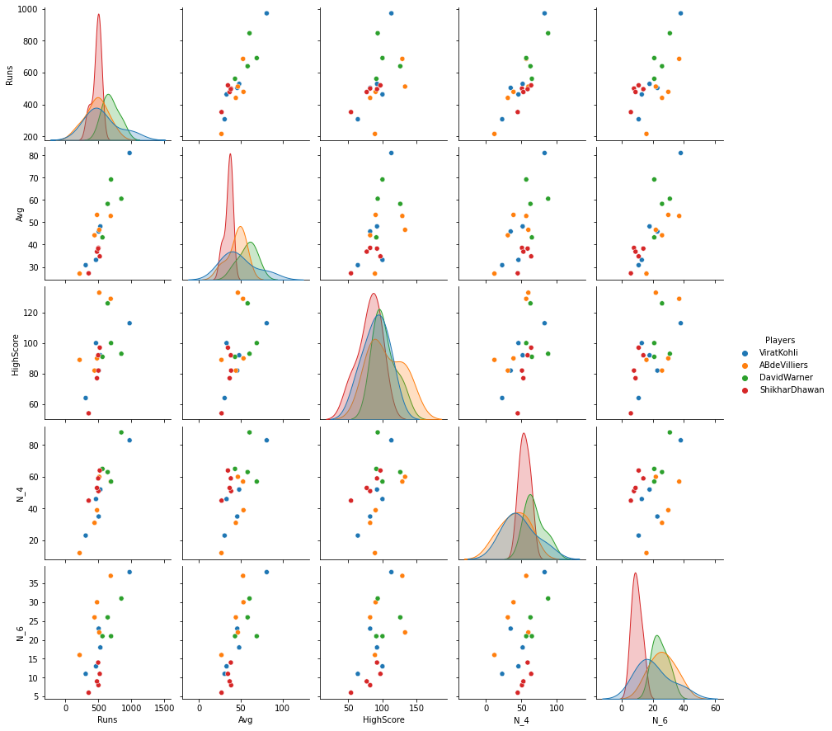
Multivariate
Pair Plot:
Pair Plot is plotted to know how the distribution of data and also to find how data is correlated
From the plot we can infer the following:
Pair plot is the combination of scatter and kde plot of the players performance of IPLT20(2015-2019)
* It shows Runs of players are positively correlated to average,N_4,high score and balls faced
* Average run rate of players are related to runs and balls faced
* Balls faced has correlation on runs, Avg and N_4

Slide 24
Conclusion
This project aims to analyse the performance of players in IPLT20(2015-2019)
Scatter Plot,HeatMap & Pair Plot
From the analysis we can infer that the total runs scored by the players in each year highly depend on he highest score, Average, N_4 and Balls faced by the players
Box Plot & Violin Plot
From the above analysis we can find that The Virat kohli has the highest runs among the season (2015-2019) but his run rate range is less than the other players
Ab de Villiers and Shikar Dhawan Run rate range is also less than other players
David Warner range of runs and highest score are higher than the other players which clearly indicates that the run rate is depended on average, Balls faced , N_4 taken which is also high for the player his performance is better than other players in IPLT20(2015-2019)

Slide 25
Future scope
We can predict the performance of the players based on the given data of past performance of the players
The consistent performer can be predicted based on their past scores and also can predict their performance in upcoming series
This way we can analyze the areas of improvement for the players to have better score and performance

Slide 26

THANK YOU

